Slide 1
UK Road Safety Data
Analysis by Darrell Wolfe

Slide 2
Dataset
The UKRoadSafetyData.zip was provided to me to use as test data for analysis practice and demonstration. Link to dataset -
Accident Data (four files, 2015-2018)
Vehicle Data (four files, 2015-2018)
Casualty Data (four files, 2015-2018)
Codes Tables (Various codes tables)
Alcohol Data – Not used in this Analysis
Unverified 2019 data – Not used in this Analysis
Tools
Microsoft SQL Server Management Studio
Microsoft Visual Studio 2022
Microsoft Excel (Power Query, CSVs)
Posit RStudio
Tableau Public
Languages
SQL
R

Slide 3
Can we prevent an accident?
If you knew you were going to get into an accident on your commute home tonight, but you could prevent it, would you want to know how?
Disclaimers:
Incomplete data or missing values are present in several measures, leading to an incomplete representation of all accidents within those metrics.
The following slides represent the question “Does this tell me anything?” Therefore, some slides will reflect that a particular measure is not significant, while others may indicate something interesting or useful. Sometimes it is the items that do not show a trend that surprised me most.
Notes:
Without any particular request included in the test data, I needed a guiding question.
My teenager is doing driver’s training right now, which made this test data timely.
Maybe this data can tell me something that will help me prevent either of us from being involved in an accident.

Slide 4
THE UK ROAD SAFETY DATASET
2015 - 2018
Note: Data from 2019 was collected but unverified. Therefore, left out of this analysis.
Notes:
Timeframe of study: 2015-2018
Accidents (unique count of Accident_Index IDs)
Casualties (count of all casualties).

Slide 5
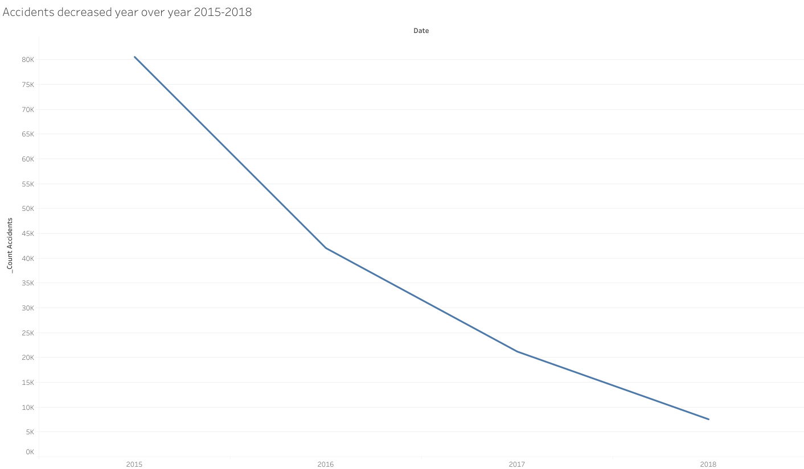
Notes:
Accidents decreased throughout the study period.

Slide 6
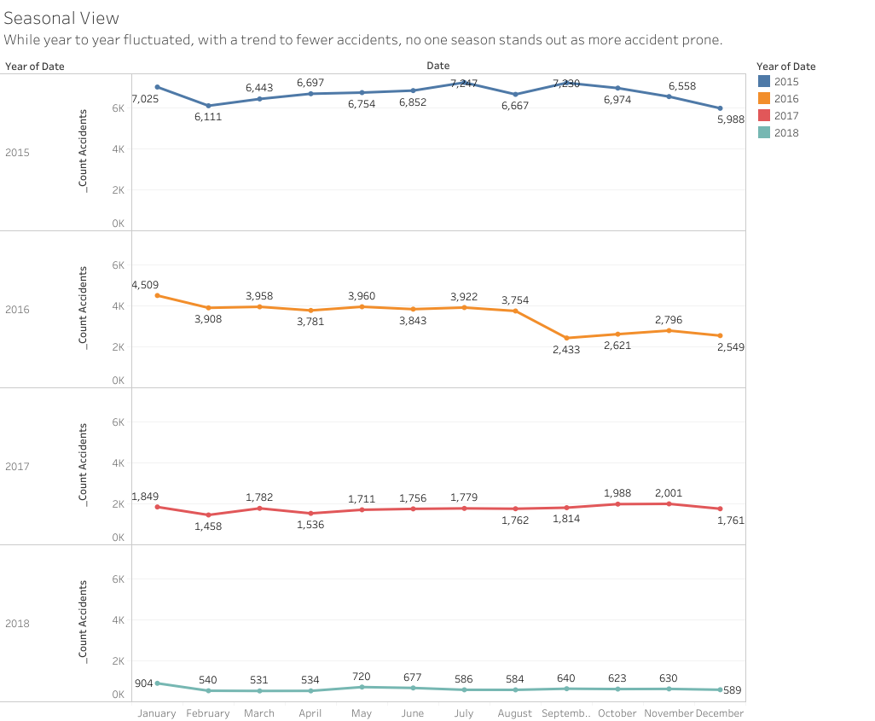
Notes:
No particular month or season more dangerous.

Slide 7
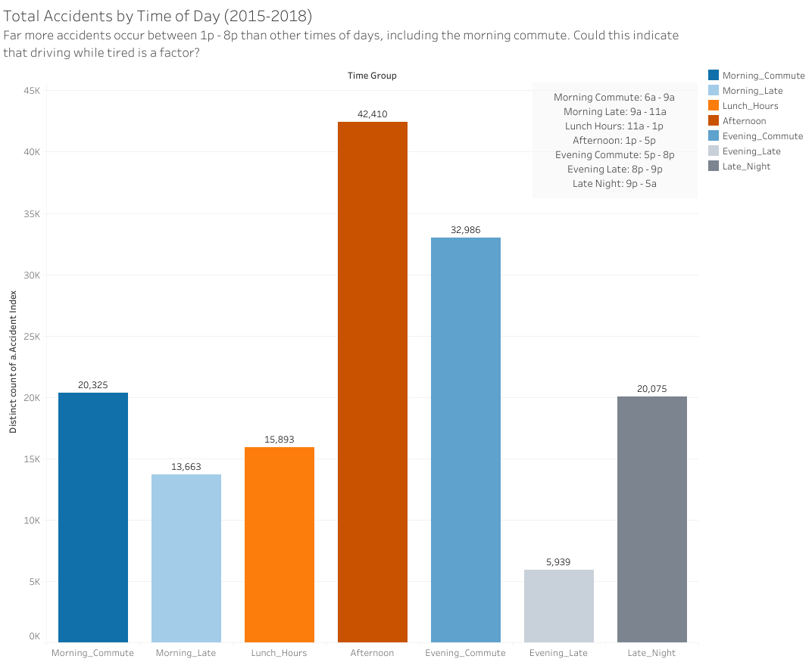
Notes:
Discuss time break-ups and key.

Slide 8
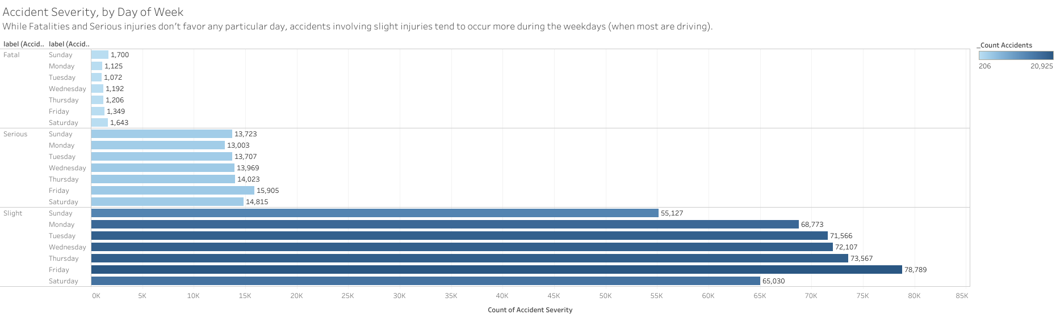
Notes:
Compare and contrast

Slide 9
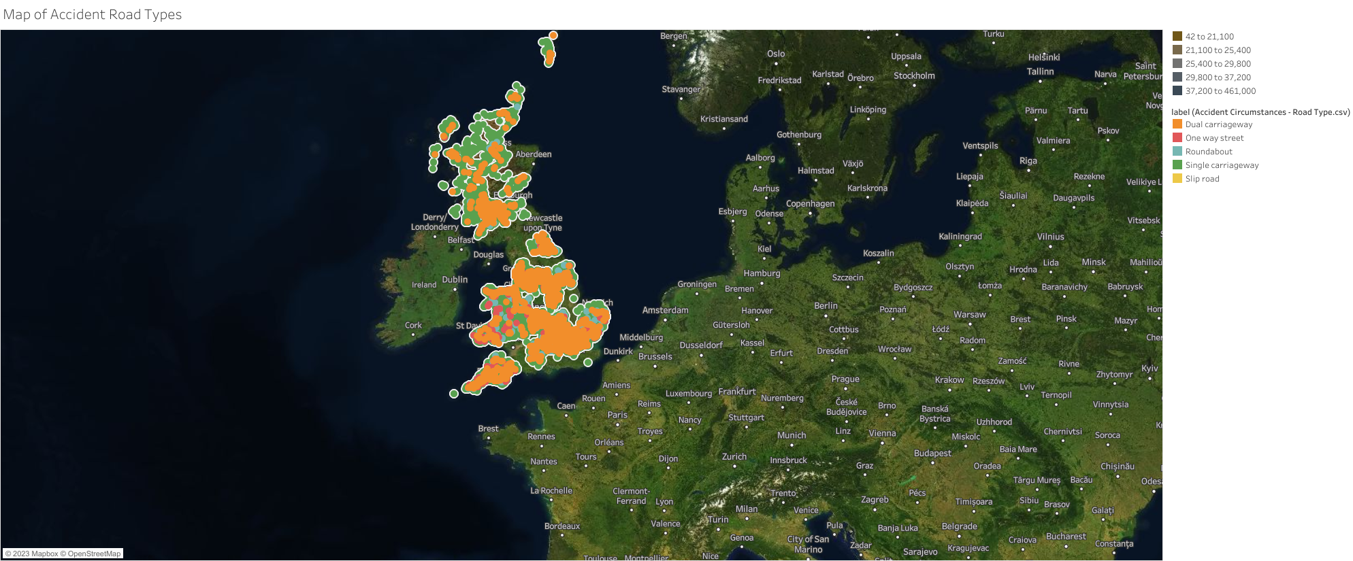
Notes:
Nothing indicated, included for reference and frankly to show I can map data.

Slide 10
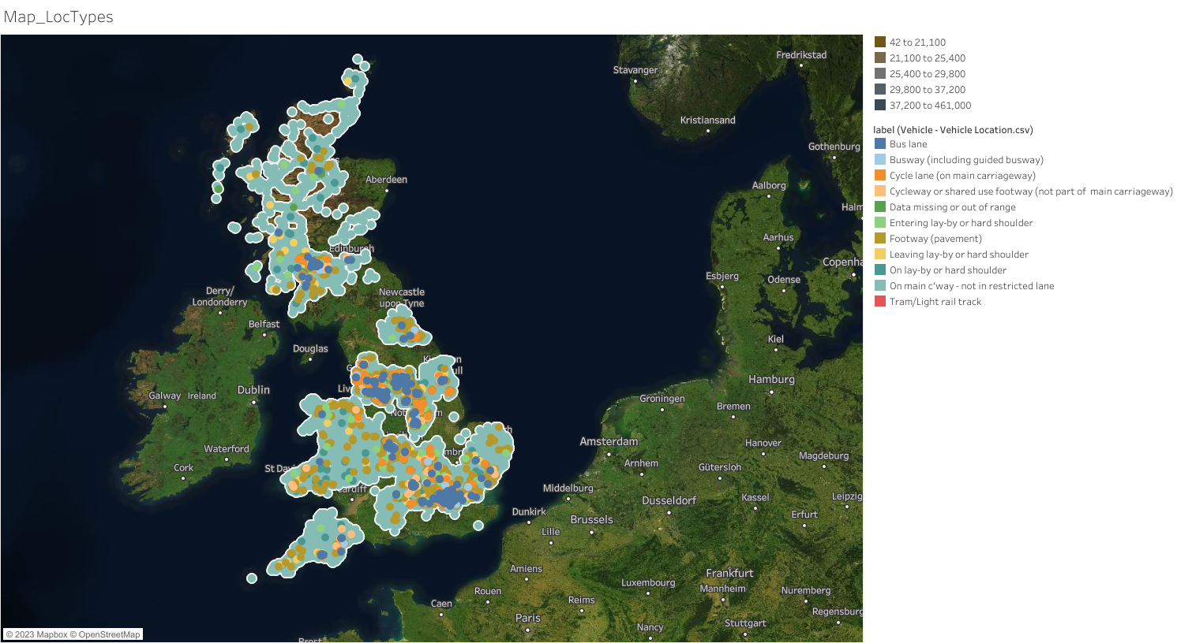
Notes:
Nothing indicated, included for reference and frankly to show I can map data.

Slide 11
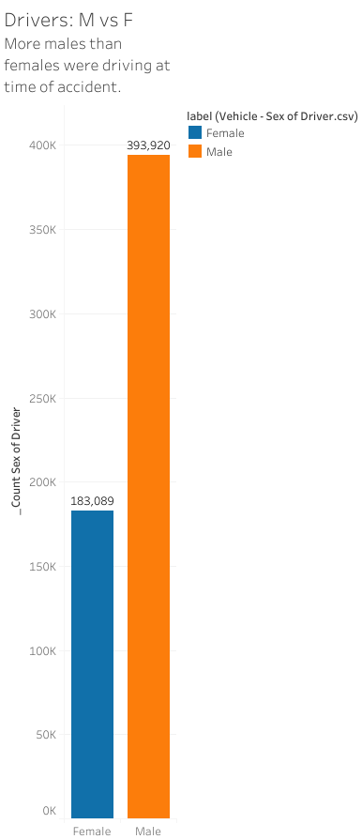
Notes:
Male drivers

Slide 12
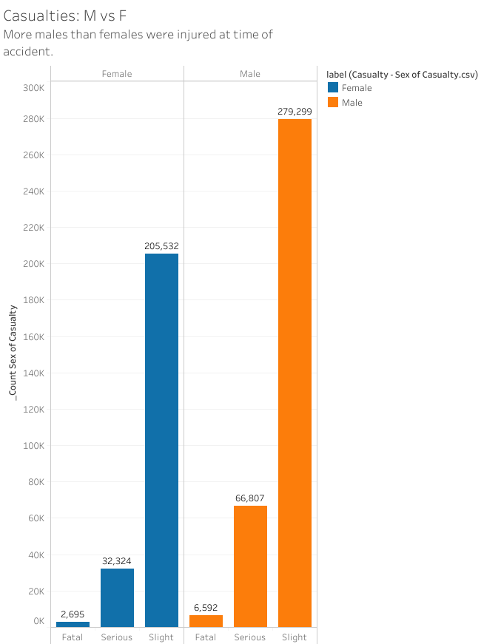
Notes:
While more males injured, the severity trends the same in both groups.

Slide 13
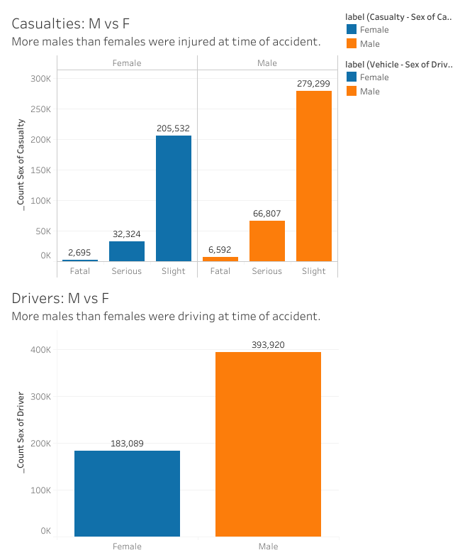

Slide 14
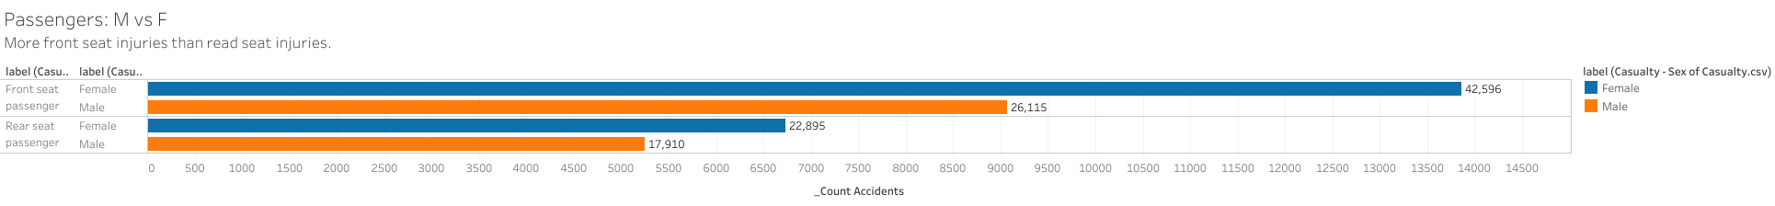
Notes:
Passengers are more often female, and rear-seat passengers are injured less often.

Slide 15
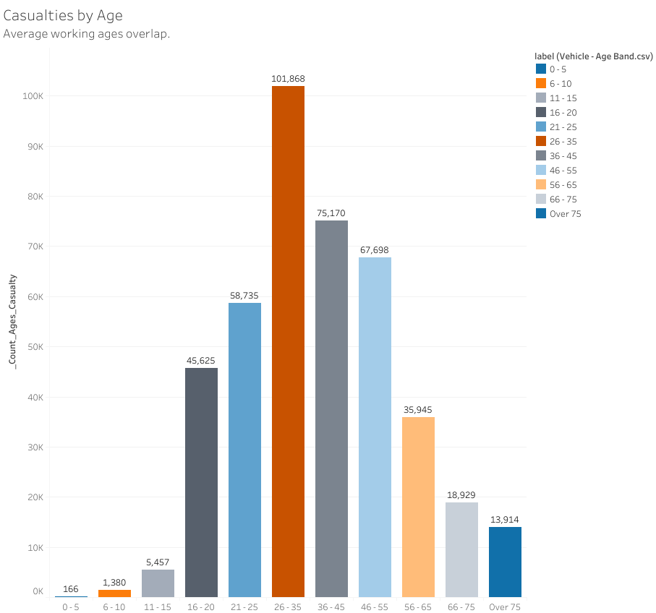
Notes:
Compare to population

Slide 16
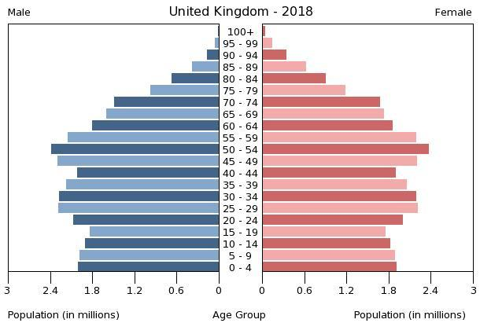
UK population pyramid (2018) WikiMedia Commons

Slide 17
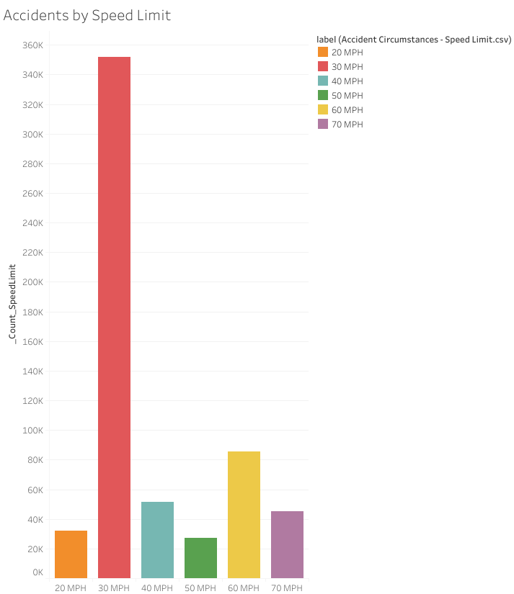
Notes:
Something is going on with 30 MPH (and should it be KMH, but the data was labeled as such). Unclear why without more time and probably more/different datasets. But this would be interesting to dig into further with more time.

Slide 18
Notes:
Urban areas over-represent accidents

Slide 19
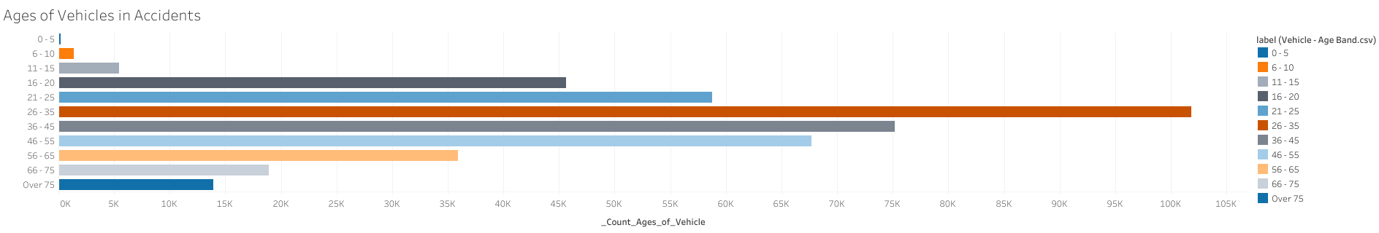
Notes:
Bell curve, is this significant, or does this represent the population? Couldn’t find that answer within the allotted timeframe.

Slide 20
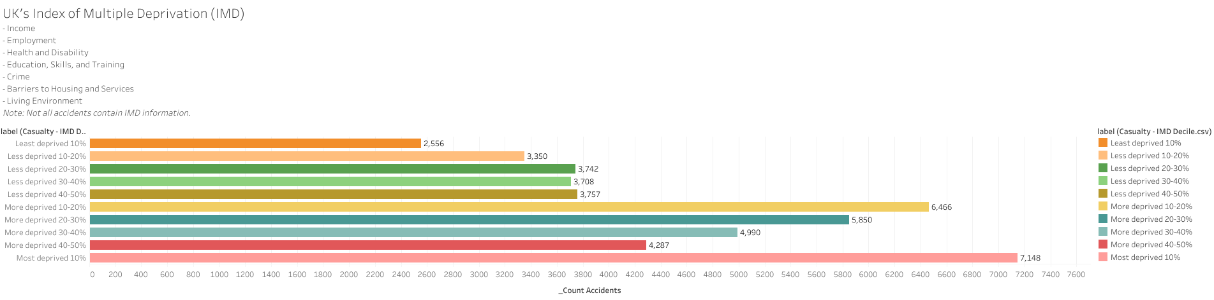
Notes:
IMD really makes me want to dive further into what other factors correlate to this.
Does this also mean the roads entities in these areas have lower budgets and they are less safe? Could be an area to further investigate.

Slide 21
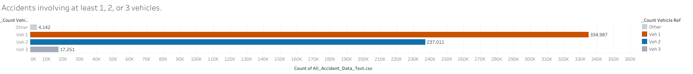
Notes:
1v2v3

Slide 22
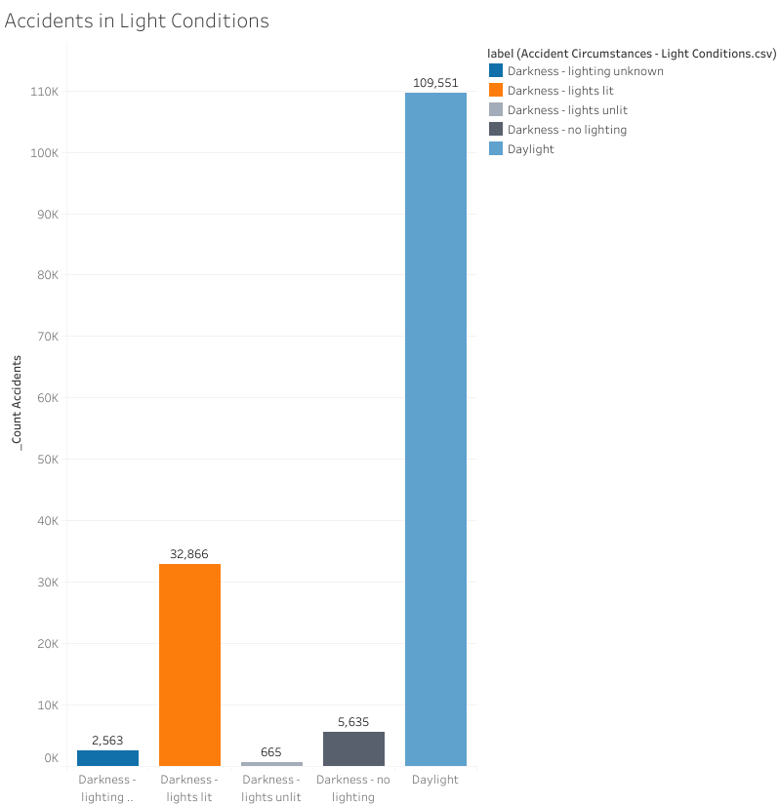
Notes:
DAY wins?

Slide 23
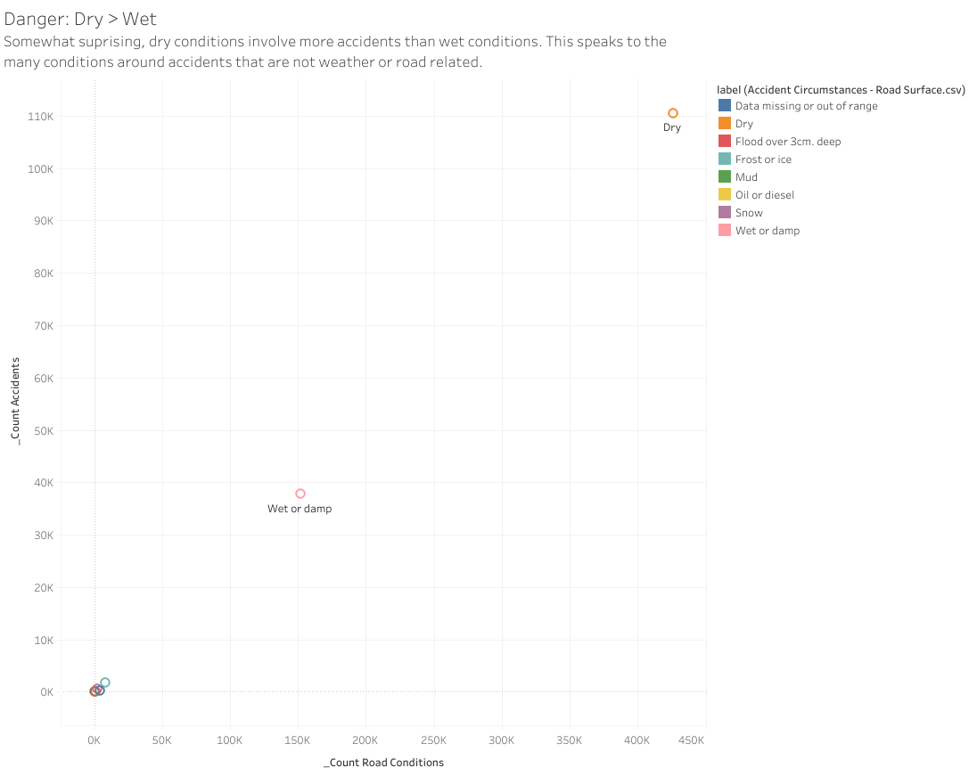
Notes:
Dry wins?

Slide 24
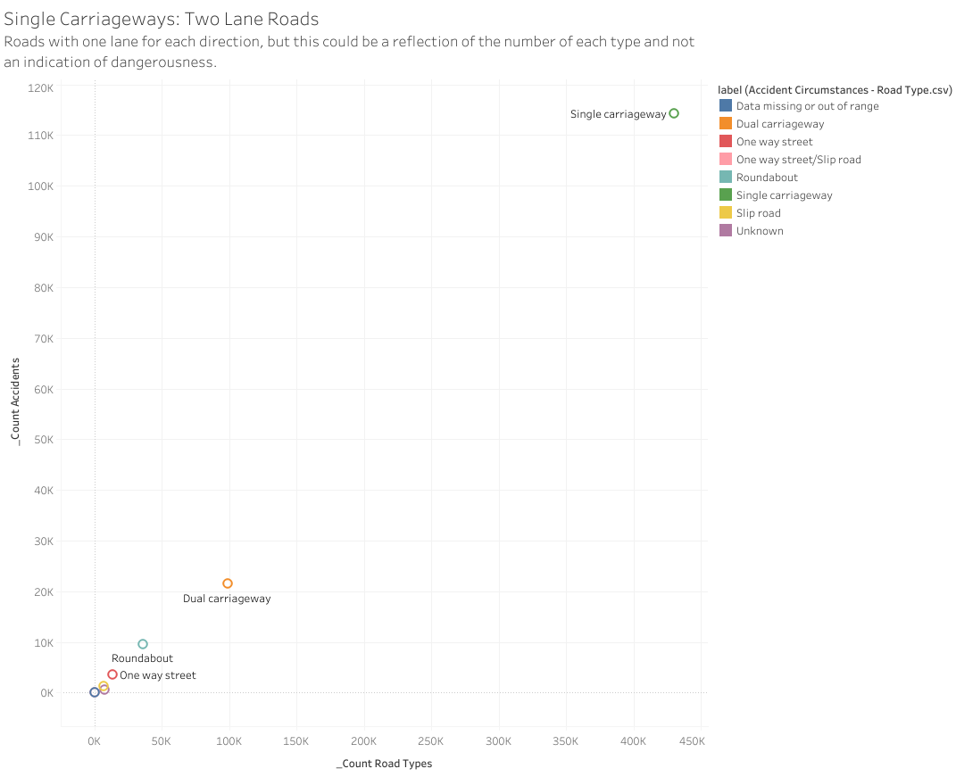
Notes:
One lane each way

Slide 25
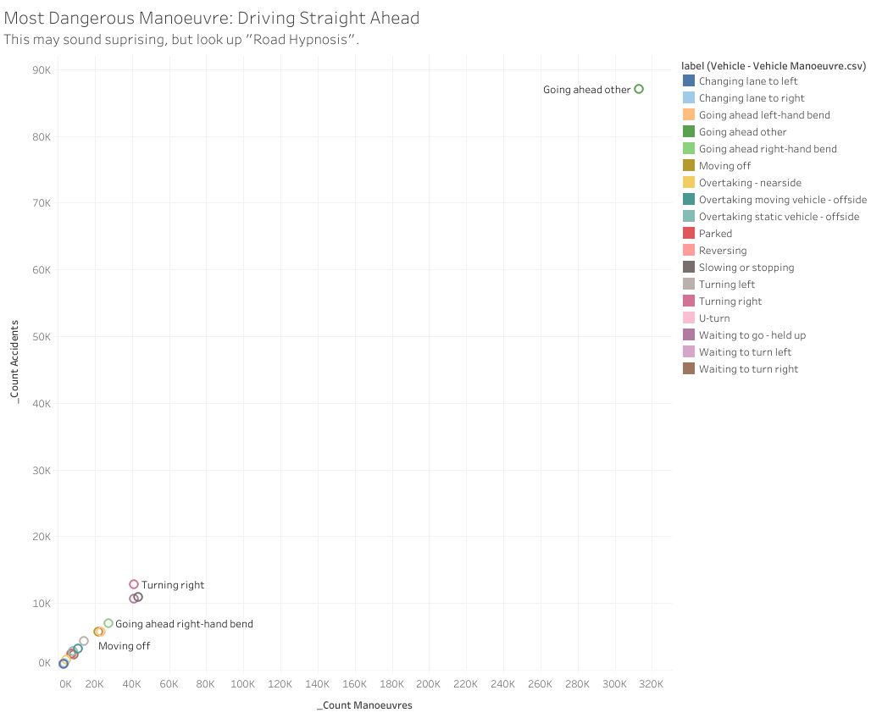
One vehicle Manoeuvre shows to be involved in more accidents than any other, "Going ahead", which indicates a state known as Road Hypnosis.¹
1. Shi, Huili, Longfei Chen, Xiaoyuan Wang, Bin Wang, Gang Wang, andFusheng Zhong. 2023. “Research on Recognition of Road Hypnosis inthe Typical Monotonous Scene.” Sensors (Basel,Switzerland) 23 (3): 1701. https://doi.org/10.3390/s23031701.
Notes:
Driving straight, not intersections, now that is fascinating.

Slide 26
Conclusions
Some conditions can make it more likely for an accident to occur.
Driving in the afternoons or on the way home after work.
Driving on long straight routes in good weather (leading to carelessness).
Driving an older vehicle, in urban city regions, or in areas where the IMD index indicates the possibility of dangerous factors.
Driving in regions where the speed limit is lower may lead to accidents (for reasons not investigated in this analysis).
Note: If a passenger, chosing the rear seat may prevent or lessen injury in case of an accident.

Slide 27
Appendix – Data Stories
The Data Stories - Details
The following data stories came to light throughout this analysis:
In 2015-2018, there were an aggregate total of 151.269 accidents and 593.391 casualties.
Accidents decreased dramatically during these years, possibly indicating a combination of safer vehicles, driver awareness, new laws, and other factors.
There were no indications that any particular month or season was more dangerous.
Weekdays are the most dangerous, especially Fridays.
While Fatal and Serious accidents do not show a preference for the day of the week, Slight injuries are reported at higher frequency on weekdays, with the highest on Fridays. Although the number of accidents have steadily dropped from 2015-2018 (the timeframe of the study).
Afternoon and Evening Commutes are most dangerous. The hours of 1p to 5p are the most likely times for an accident, followed closely by the hours of 5p to 8p. Most accidents occurred during daylight, following by well lit nights, which coincides with these findings.
Note: the "Evening Late/Late Night" categories could have been spread across times better. This was an oversight and would be corrected upon an updated version.
Types of Roads and Lanes did not show any particularly interesting patterns, but two maps were included as reference.
While there were more male drivers than female, and more male casualties than female, the distribution of injuries Fatal, Serious, and Slight were correlated to those numbers and did not reveal anything interesting.
However, while males were the driver more often, females were injured as passengers more often. And rear-seat injuries were far less common than front seat injuries.
One vehicle Manoeuvre shows to be involved in more accidents than any other, "Going ahead", which indicates a state known as Road Hypnosis.[@shi2023]
Ages: While at first ages seem to show more accidents for those 26-35 with a bell curve on either side, this also correlates with the working population. Therefore, this may only be a reflection and not an indication. When comparing this to the population data (from WikiMedia Commons), this guess held true.
Speed Limit: One speed limit (30 MPH (or is that KMH?) has a higher representation of accidents than all others. This seems highly correlated with the fact that most accidents occur in urban city areas and during afternoon or commute hours.
Vehicles 26-35 years old played an outsized role in accidents, however, the age bands showed a bell curve, which is likely an indication of the population of vehicles available for accident incidents.
The Index of Multiple Deprivation (IMD) did show that accidents in deprived regions were higher, this may reflect multiple factors including access to safer vehicles and local budgets for road maintenance.
Accidents involving one vehicle were most common, followed by those involving two, with a representation for third vehicles. Very few involved more than three.
Surprisingly, most accidents occurred with one vehicle in daylight hours on dry single-lane roads, while driving straight ahead (not while navigating a turn or intersection).
This reminded me of a term I had heard called Road Hypnosis; which is especially important in North Idaho, USA. This occurs when the driver is taking a well-known route and driving straight ahead. The human brain has evolved to only store important information, and a well-known straight route does not fall into this category. The brain goes into a form of autopilot, and drivers sometimes tell stories of having arrived at home after work without remembering the drive. In this auto-pilot state, one can miss clues that something has changed or even drift off the road entirely.

Slide 28
Appendix – Data Analysis Details
Technical Review:
For those wanting to review the more detailed technical review.
Web Based: UK Road Safety, Technical Analysis, Darrell Wolfe, (Temporary Demo Page - Topos Creative, LLC)
Word/PDF: Google Drive: Word Doc & PDF Doc
Tableau Public:
Link Here
GitHub:
- GitHub_UK Road Safety Repo
Google Drive:
Link to files used for this exercise, including the Power Query transformation and re-organized CSVs.
- UK Road Safety, Darrell Wolfe Analysis, Google Drive Files

